Slide 1
ECB1323 - ANTENNA AND MILLIMETRE WAVE COMMUNICATION
DESIGN OF AN EFFICIENT MULTIBAND ANTENNA FOR TERRESTRIAL APPLICATIONS
Presented By:
KANISHKA S(927623BEC102)
KANISHKAA S(927623BEC103)
KIRUBA D(927623BEC112)

Slide 2
Problem Statement:
Traditional antennas usually operate at a single frequency band and have limited bandwidth and gain. With the rapid growth of wireless communication technologies, there is a need for compact antennas that can support multiple frequency bands and adapt to changing requirements. The main problem addressed in this project is designing a small, multiband, and reconfigurable antenna with improved performance for terrestrial communication systems.

Slide 3
Abstract:
This project presents a Reconfigurable Multiband Antenna using Split Ring Resonators (SRR) and a Meta surface Reflector for terrestrial wireless applications.
The SRR structure enables multiple resonant frequencies, allowing the antenna to operate in different communication bands.
The meta surface reflector improves gain and radiation performance by controlling electromagnetic wave propagation.
The proposed antenna is compact, efficient, and suitable for modern systems such as 4G, 5G, Wi-Fi, and IoT.

Slide 4
Introduction:
Modern systems like 5G Communication require high-performance antennas. Conventional Microstrip Patch Antenna supports only single frequency
Need for multiband antennas to handle multiple services. Reconfigurable antennas can switch between frequencies
Split Ring Resonator (SRR) is used to create multiple resonant frequencies. Metasurface improves gain and radiation performance
Helps to reduce antenna size and cost. Suitable for terrestrial wireless communication applications. Provides better efficiency and flexibility

Slide 5
Objective:
The objective is to design a compact multiband antenna using SRR structures for operation at multiple frequencies in a small size, while improving gain and radiation performance using a meta surface reflector.
Scope of The Project :
The project focuses on terrestrial wireless applications like 4G, 5G, Wi-Fi, and IoT. The work includes antenna design, simulation, optimization, and performance analysis. Prototype fabrication and testing can be done for practical validation.

Slide 6
Literature Survey:
S.No | Author(s) | Paper Title | Year | Methodology | Key Findings
1 | C. A. Balanis | Antenna Theory: Analysis and Design | 2016 | Analytical modeling of microstrip antennas using cavity model | Established fundamental design equations for circular patch antennas with moderate gain and narrow bandwidth
2 | G. Kumar, K. P. Ray | Broadband Microstrip Antennas | 2013 | Use of bandwidth enhancement techniques like slots and substrate optimization | Improved bandwidth and impedance matching compared to basic designs
3 | Y. Li et al. | Metamaterial-Based Circular Patch Antenna | 2018 | Integration of SRR/CSRR metamaterial structures in patch antenna | Achieved multiband operation, compact size, and improved gain
4 | A. Kumar, R. Singh | Circular Patch Antenna with Defected Ground Structure | 2020 | Introduction of DGS (slots in ground plane) to modify current distribution | Enhanced bandwidth, better S11 and VSWR performance
5 | X. Zhang et al. | Metasurface Antenna for 5G Applications | 2022 | Use of metasurface array and periodic structures for high-frequency operation | Achieved high gain, wide bandwidth, and suitability for mmWave/5G systems

Slide 7
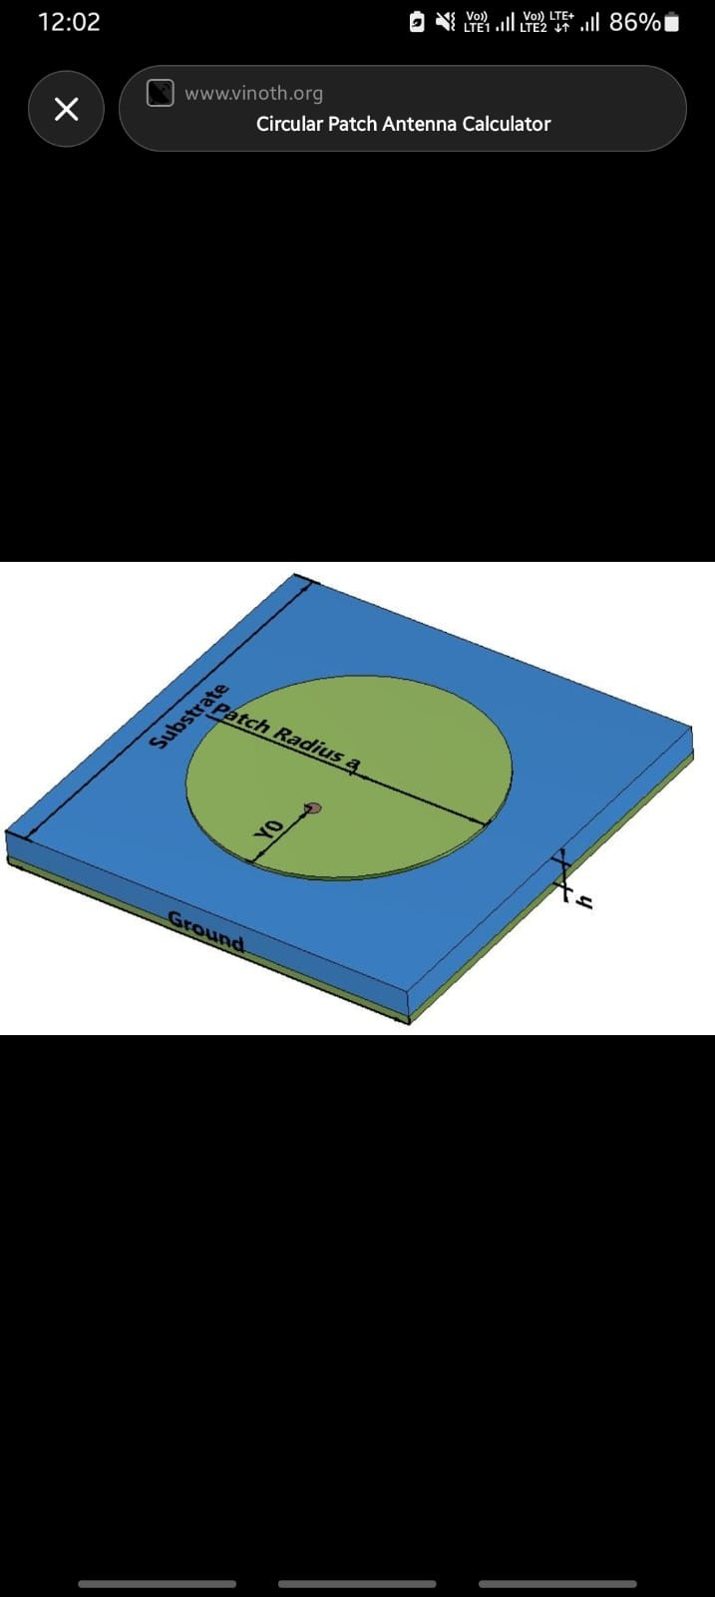
PAPER 1
Title: Metamaterial Inspired Frequency Re-Configurable Antenna for Sub-6 GHz Applications
Authors: M. Monika, P. Uchariya,
Year: 2025
Summary: A metamaterial microstrip patch antenna using PIN diodes for frequency reconfiguration, suitable for IoT applications.
Gain: ~1.68 dB at 3.6 GHz
Efficiency: ~81 % at 3.6 GHz

Slide 8
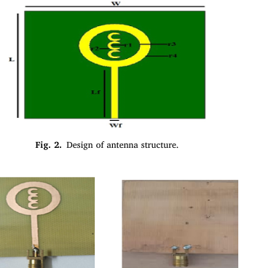
PAPER 2
Title: Design implementation analysis of multi-band antenna for terrestrial applications
Authors: Jiahao Zhang, Buyun Wang, Sen Yan, Wei Li, Guy A.E. Vandenbosch
Year: 2024
Length × Width: D = 30 mm → L ≈ 30 mm, W ≈ 30 mm
Operating range: 1.7–2.2 GHz (varactor-tuned).

Slide 9
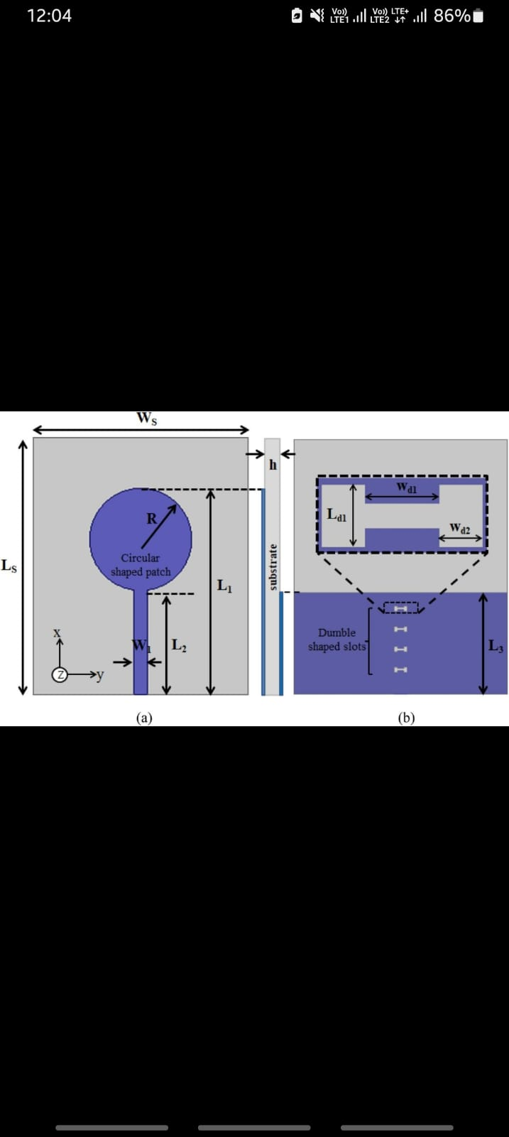
PAPER 3
Frequency Reconfigurable Antenna for Multi Standard Wireless and Mobile Communication Systems
Authors: (Navneet Kaur, Jagtar Singh Sivia, Rajni)
Substrate: FR-4 (εr ~4.4, thickness ~1.6 mm).
Length × Width: 30 mm × 20 mm × 1.6 mm
Gain: ~2.05 dBi (Mode 1), ~1.87 dBi (Mode 2), ~1.4–1.75 dBi

Slide 10
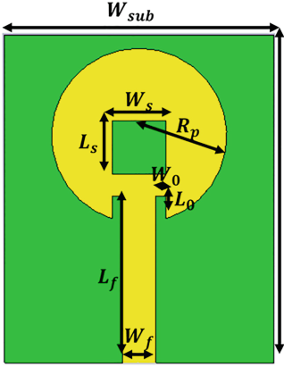
PAPER 4
Title: Reconfigurable Millimetre Wave Metamaterial Antenna for 5G
Authors: C. S., D. N. Chandrappa, S. Jagadeesha,
Year: 2024
Gain: ~8.45 dB
VSWR: ~2.3
Bandwidth: ~3.5 GHz

Slide 11
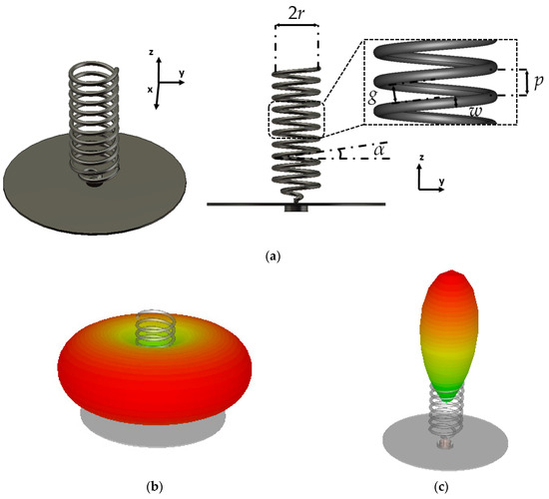
PAPER 5
Author: M. K. Meshram et al. (2026)
Title: “Frequency Reconfigurable Circular Patch Antenna Using Varactor Diode for Multiband Applications”
Substrate: Rogers RT/Duroid 5880 (εr = 2.2, h = 0.79 mm)
Patch Dimensions: Length ≈ 3 mm, Width ≈ 4 mm
Results: Resonant Frequency = 29.8 GHz
Return Loss (S11) < −12 dB
VSWR < 2
Gain ≈ 8 dB Bandwidth ≈ 1 GHz

Slide 12
Antenna Parameter:
1. Resonant Frequency (fr):
The frequency at which the antenna radiates maximum power and operates efficiently.
fo = c / (2L√εeff)
Where: c = speed of light (3×10^8 m/s)
L = length of patch
εeff = effective dielectric constant
2. Return Loss (S11):
Return loss measures how much power is reflected back from the antenna due to impedance mismatch.
S11 ≤ −10 dB
RL = −20 log|Γ|

Slide 13
Antenna Parameter:
3. VSWR (Voltage Standing Wave Ratio)
VSWR indicates how efficiently RF power is transmitted from the source to the antenna.
VSWR ≤ 2
VSWR = (1 + |Γ|) / (1 − |Γ|)
4. Gain:
Gain represents the ability of the antenna to direct radiated power in a particular direction.
G = η × D
5. Bandwidth
Bandwidth is the range of frequencies over which the antenna performs effectively (S11 ≤ −10 dB).
BW = fH − fL

Slide 14
Antenna Parameter:
6. Radiation Pattern
Radiation pattern shows how the antenna radiates energy in space.
7. Free Space Wavelength (λ)
Wavelength of the signal in free space.
8.Guided Wavelength (λg)
Guided wavelength is the wavelength inside the dielectric substrate.
λg = c / (f √εeff)
Where:c = 3×10^8 m/sf = frequency
εeff = effective dielectric constant
9.Wavelength
Wavelength is the distance between two peaks of a wave.
Formula:λ = c / f

Slide 15
Design Equation :
1)Patch Width (W)
W = (c / (2 * fr)) * sqrt(2 / (εr + 1))
W = (3×10^8 / (2×2.4×10^9)) * sqrt(2 / 5.4)
W ≈ 0.038 m = 38 mm
2) Effective Dielectric Constant (εeff)
εeff = (εr + 1)/2 + (εr - 1)/2 * (1 + 12h/W)^(-1/2)
εeff = (4.4 + 1)/2 + (4.4 - 1)/2 * (1+12×0.0016/0.038)^(-1/2)
εeff ≈ 4.08

Slide 16
Design Equation :
3) Length Extension (ΔL)
ΔL = 0.412h * ((εeff + 0.3)(W/h + 0.264)) / ((εeff - 0.258)(W/h + 0.8))ΔL
≈ 0.8 mm
4) Guided Wavelength (λg)
λg = c / (fr × √εeff)
λg = 3×10^8 / (2.4×10^9 × sqrt(4.08))
λg ≈ 0.0618
m = 61.8 mm

Slide 17
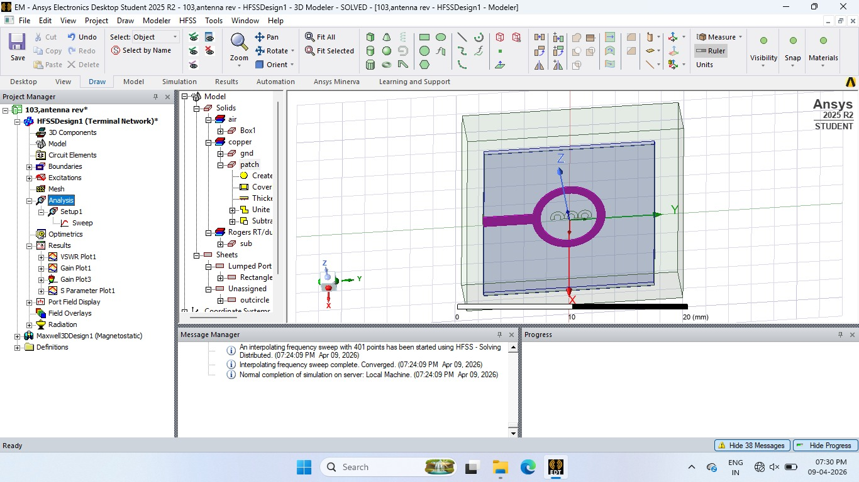
Simulation Result:

Slide 18
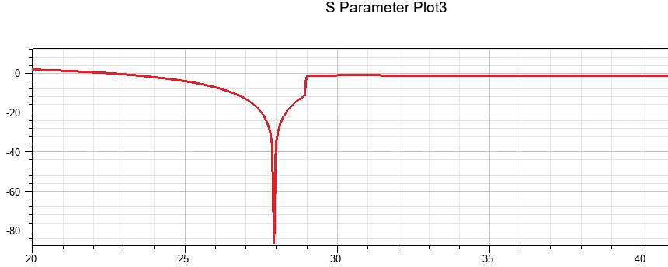
S Parameter:

Slide 19
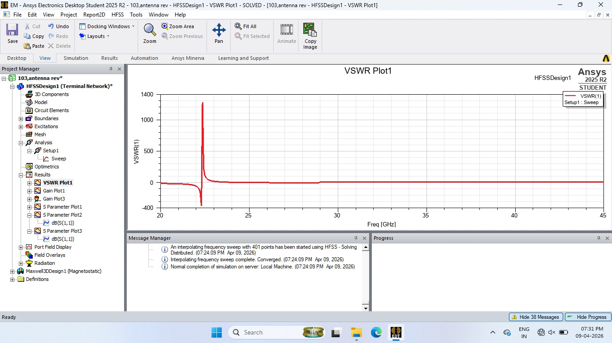
VSWR:

Slide 20
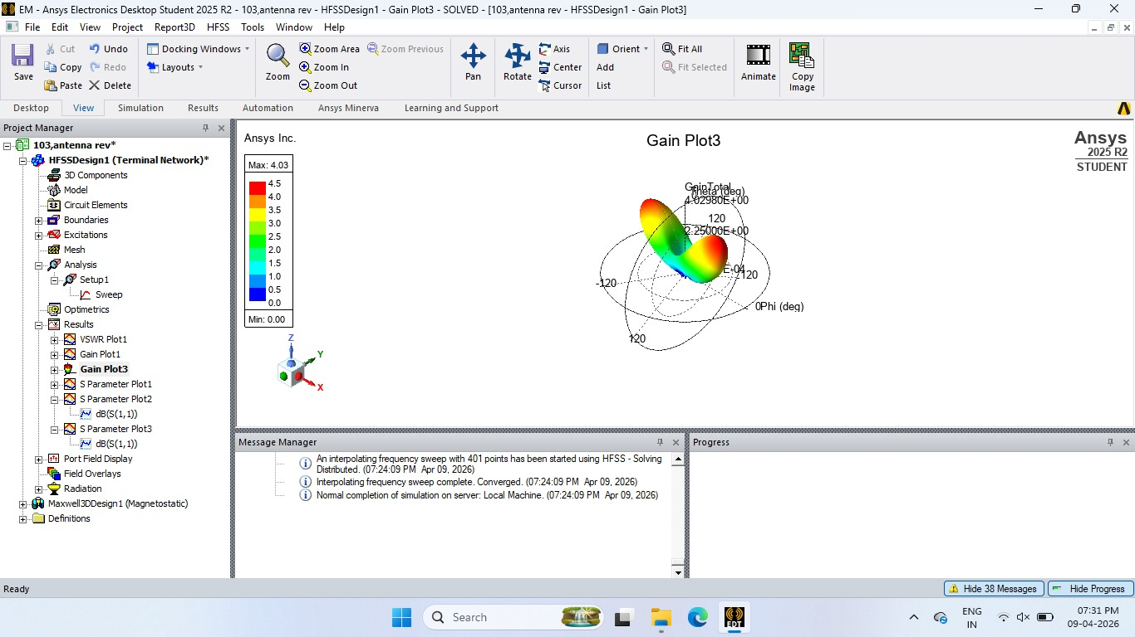
RADIATION PATTERN:

Slide 21
Comparision:
Parameter | Paper 1 | Paper 2 | Paper 3 | Paper 4 | Paper 5 | Proposed Paper
Antenna Type | Circular patch antenna | Varactor-tuned circular antenna | Circular SRR antenna | Circular patch with DGS | Circular metasurface antenna | Improved circular reconfigurable metasurface antenna
Design Approach | Basic circular patch | Diode-based tuning | SRR loading | Ground defect structure | Array/metasurface structure | SRR for multiband , adding reconfigurable elements and using a metasurface
Frequency Operation | Single band | Multiband/tunable | Multiband | Wideband | High-frequency / mmWave | Multiband + tunable
Gain | 2–4 dB | 3–6 dB | 4–7 dB | 5–8 dB | 8–12 dB | 8–12+ dB(expected)
VSWR | 2.0 – 2.5 | 1.5 – 2.0 | 1.3 – 2.0 | 1.2 – 1.8 | 1.1 – 1.5 | ~1.1 – 1.3
Bandwidth | Narrow | Moderate | Moderate | Wide | Wide | Enhanced wideband
Size | 90*90*1.6 | 84*84*1.6 | 75*75*1.6 | 81*81*1.6 | 60*60*1.2 | 54*54*1.2
Resonant frequency | 2.4GHz | 2,3GHz | 3.5,5.2GHz | 2.4,3.5GHz | 28,30GHz | 2.4,3.5GHz
S11 | -10dB to -15dB | -12dB to -18 dB | -15 dB to -20dB | -18 dB to -25 dB | -20 dB to -30 dB | <-25 dB
Applications | Basic wireless | Multiband communication | Compact devices | Wi-Fi/WLAN | 5G/mm Wave | IoT, Wi-Fi, 5G (multi-use)

Slide 22
Conclusion:
The design and analysis of the circular microstrip patch antenna show that antenna performance can be significantly enhanced by using advanced techniques such as metamaterial structures, split ring resonators (SRR), defected ground structures (DGS), and reconfigurable elements. Compared to conventional designs, which often suffer from limited bandwidth, moderate gain, and higher return loss, the proposed antenna achieves improved results with lower S11 (≤ −25 dB), better impedance matching (VSWR close to 1), and enhanced gain and bandwidth. The circular geometry ensures compact size and symmetrical radiation characteristics, while the integration of modern design approaches enables multiband and flexible operation. Hence, the proposed antenna is well-suited for modern wireless applications such as Wi-Fi, IoT, and 5G communication systems, offering improved overall efficiency and performance.

Slide 23
Reference:
M. Monika, P. Uchariya, P. Ranjan, and S. Kumar, “Machine learning assisted frequency reconfigurable concentric split ring resonator inspired antenna for sub-6 GHz 5G and IEEE 802.11ba/be applications,” AEU – Int. J. Electron. Commun., vol. 200, pp. 155889, Oct. 2025.2.
C. S., D. N. Chandrappa, S. Jagadeesha, S. K. Sreedharamurthy, M. V. Chaitanya Kumar, and K. Prathibha, “Design of Frequency Reconfigurable Antenna with Split Ring Resonator and Diode Control for Omnidirectional Applications,” J. of Electrical Systems, vol. 20, no. 10s, 2024.
M. Selvaraj et al., “Reconfigurable Meta surface: Enabling Tunable Reflection in 6G Wireless Communications,” Sensors, vol. 23, no. 22, 2023.
P. Natarajan and T. Sigamani, “Design implementation analysis of multi-band antenna for terrestrial applications“Heliyon, vol. 10, 2024.

